Slide 1

Apx Initial allocation
MANUAL

Slide 2
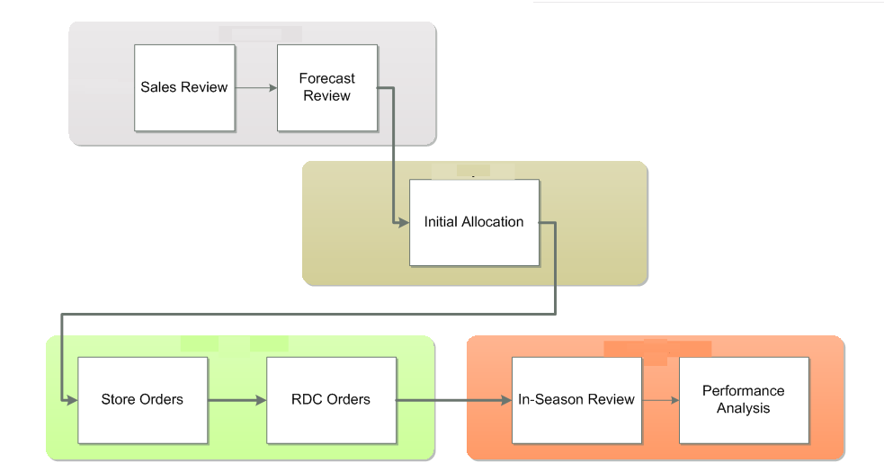
PROJECT FLOW

Slide 3
Initial allocation
introduction

Slide 4
introduction
LMG Allocation Functional Overview
Functionally, the LMG Allocation process can be split into the following steps, in chronological order:
Stock Received
Initial Allocation Approved
Phase Ends
Months
PO Raised
PO Re-split

Slide 5
introduction
LMG Initial Allocation Mechanisms
RDC Cross-docking: Upon receipt of an initial shipment from a supplier at an RDC, initial allocation orders should be cross-docked for shipment to stores without being put to stock-on-hand.
To accommodate this, CPR will allow for the Cross-Docking of Allocation orders against the “active” ASN quantity which is defined as the shipment which, for each RDC/Option/PO combination:
Has the earliest shipment date, and
Has not been received by an RDC
Does not have an Allocation Order already issued against it by CPR
Shipment from Stock On Hand: Normal shipment of Allocation Orders from either CDC or RDC Stock On Hand

Slide 6
introduction
LMG Initial Allocation Concepts – Planned Initial Allocation
During the assortment planning stage, planners will create an Initial Allocation plan for each Option/Store
After Oracle Assortment Planning is deployed, this Allocation Plan will be defined at Pack group/Store, with a planned allocation quantity (in units) per Pack group/Store
After the PO has been raised users will be able to update the Initial Allocation Plan using PO Quantity as a top-level constraint to create the final Allocation plan to be executed when stock arrives

Slide 7
introduction
LMG Initial Allocation Concepts – Order Release
Following receipt of PO stock, the APX module of CPR will suggest Allocation Order quantities to the Landmark business users who will then review them and potentially release them for Allocation.
Allocation quantities will be released manually by APX users depending on
ASN information for each PO for : orders will be cross-docked upon arrival at the RDC
Stock on-hand at the distribution centers: orders will be executed next business day
Allocation quantities will also depend on the assortment of products that can be sent together at the same time – e.g. products that belong to the same collection or flow.
Further, for some concepts (Max, Splash, others) the set and quantity of products that will be allocated should follow store-level constraints, such as display capacity or category-management issues

Slide 8
introduction
LMG Initial Allocation Concepts – Delayed Stores
Landmark may include Store locations in their initial allocation plans whose opening is delayed or for which the final location may be still undetermined at the time of the original assortment plan.
For these locations, APX should allow users to create temporary (placeholder) stores which will be assigned the planned allocation quantities.
APX should provide the capability to hold their allocation stock at an appropriate RDC or CDC location
When these stores are finalized, the APX users should be able to release the allocation stock for actual allocation orders
On the other hand, if the stores are cancelled, users should be able to release the stock reserved for initial allocation to these stores and re-use it for replenishment of other locations.

Slide 9
introduction
LMG Initial Allocation Order Approval and Execution Overview
APX Initial Allocation Batch
WMS
APX Initial Allocation Workbook
CDC → RDC Allocation Transfer Order Approval (Automatic)
RDC Cross Docking Allocation Order Approval (Manual)
RDC On Hand Allocation Order Approval (Manual)
APX Order Export to WMS
Order Execution
RDC Cross Docking Order Recommendation
RDC On Hand Order Recommendation

Slide 10
Initial allocation
Scenario Ap initial allocation review

Slide 11
AP initial allocation review
New Changes related to Initial Allocation Change Request.
1. Recommended Initial Allocation quantity suggested by APX will be restricted based on the Initial Allocation Qty at Option level defined by the Business Users on Buy Plan template.
2. Any pack with Pack Configuration lower than the smallest Initial Allocation Qty available in the buy plan should not be considered eligible during initial allocation process.
For example, if the buy plan initial allocation qty for one Option is 18 for few stores and 24 for all the other stores and the available packs for this Option consist of 2, 6, 12 218 units, APX should take into account only the pack of 18 units for initial allocation process and the other packs should be eligible only for replenishment. If the buy plan initial allocation qty for one Option is 24 units for all stores and the available packs are the same as above, all packs should be excluded since they are smaller than the initial allocation qty and there will be no initial allocation for this Option).
In case, all packs are smaller than Initial Allocation, users may define a placeholder store and allocation “minimum required pack-1’ packed units for the store in order to make all packs above this configuration valid for Initial allocation.
Impact on Replenishment – The pack configuration of all packs will be checked against the smallest Initial Allocation qty and a boolean mask will be store the packs having higher configuration value than that. The remaining packs will be excluded from Initial allocation and will be stored in different boolean mask.
Packs used in Initial allocation will not be used in Replenishment and vice versa.

Slide 12
AP initial allocation review
Related Concepts
AP Initial Allocation (Packed units): the initial allocation quantity as entered in Assortment Planning (AP).
Reconciled AP Initial Allocation (Packed units): the recommended initial quantity as calculated by the APX replenishment engine based on the Initial Allocation Parameters, using the PO Quantity (minus the Holdback Quantity) as a top-level constraint
Difference between Reconciled and AP Initial allocation (Packed units): For review purposes; the difference between Reconciled and AP Initial allocation to allow sorting for outliers.
AP Initial Allocation % (Packed units): For review purposes; the percentage of AP Initial Allocation for this Store across the RDC/Pack group for Packed units
Planned Allocation %: For review purposes; the percentage of Planned Allocation Quantity for this Store across the RDC/Pack group for Packed units.
Planner Quantity Override : APX users will be able to enter their overrides for the initial Allocation Quantity. APX should then reconcile the PO Quantity (minus the Holdback Quantity) with the override and create the final Planned Allocation Quantity.
Planned Allocation Quantity: As described above, the final allocation plan to be executed when stock arrives, calculated as: If Planner Quantity Override is different than AP Initial Allocation, Planner Quantity Override, else PO Quantity – Holdback Quantity.
Planned Initial Allocation cannot be satisfied: APX will flag this measure as True if the total quantities of Planned Allocation Quantity for the Pack group across all Stores in the RDC exceed the total PO quantity for the Pack group planned to be received at the RDC.

Slide 13
AP initial allocation review
Related Concepts
Allocation Status: APX will set this measure to the following status messages:
“AP Plan” if Planned Allocation Quantity (Packed units) is the same as AP Initial Allocation (Packed units) for this RDC/Store/Pack group.
“Planner Override” if not.
RDC ASN Quantity (Packed units): This measure will contain the total quantity shipped in the “active” ASN users are reviewing in the workbook.
Active ASN id: This will contain the ID of the Active ASN for the RDC/Store/Pack group combination as interfaced in from WMS/ER
Pack Configuration: a string describing the pack size split, e.g. “1-2-2-1” will describe a 6-unit pack containing 4 sizes with the respective quantities per size.
Pack Configuration (Volume): the size of the pack; for the example above this measure will be equal to 6.
ROI Rank: the Store Rank per Pack Group based on ROI.
RDC To-Be Allocated (Packed units): The difference between the total Planned Allocation Quantity and In Transit from CDC (Packed units).

Slide 14
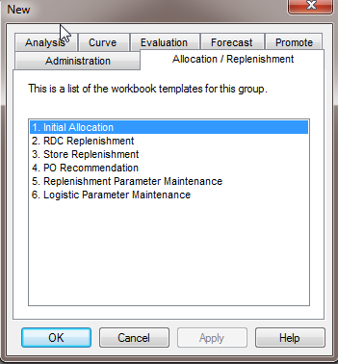
AP initial allocation review
Review AP Initial Allocation, create and approve new plan
From the workbook tab “Allocation/Replenishment” select "Initial Allocation" as workbook template type and click "OK”.

Slide 15
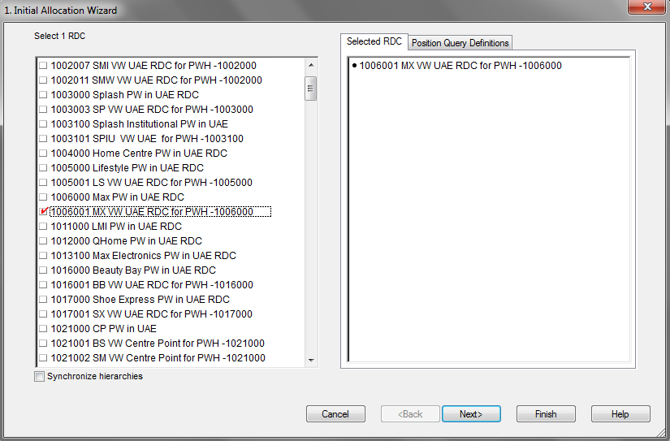
AP initial allocation review
Review AP Initial Allocation, create and approve new plan
The “Initial Allocation Wizard” appears and prompts you to select one RDC. Proceed to an RDC selection.

Slide 16
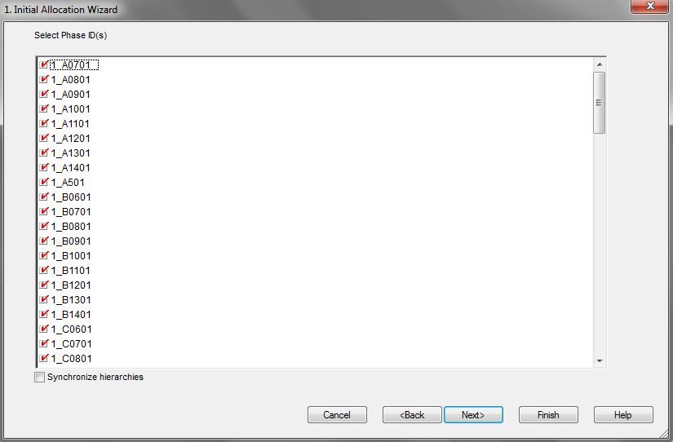
AP initial allocation review
Review AP Initial Allocation, create and approve new plan
Select Phase IDs for review.

Slide 17
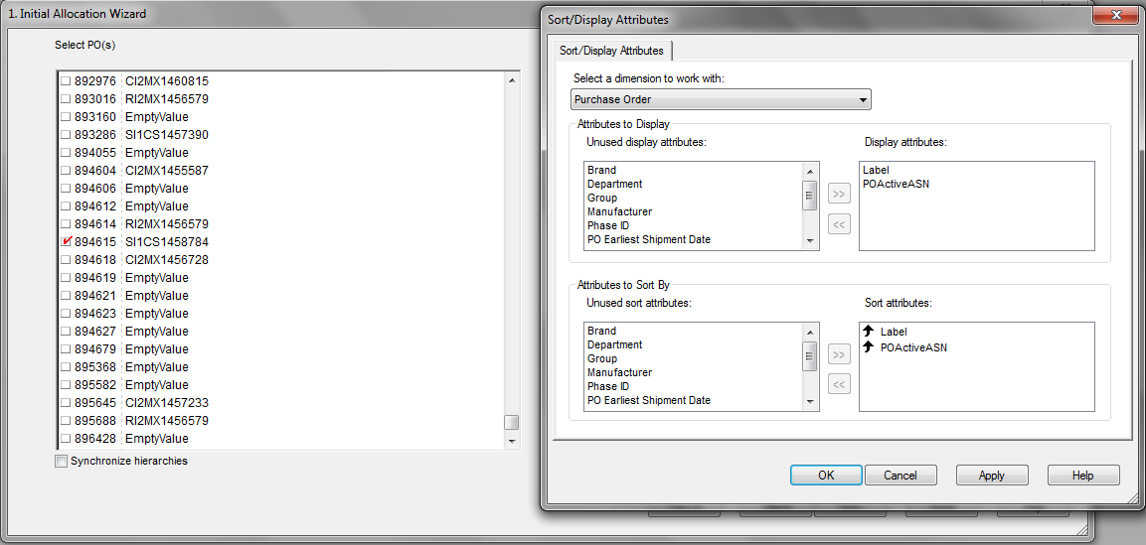
AP initial allocation review
Review AP Initial Allocation, create and approve new plan
Select Purchase Order(s) for review. Proceed with the list of POs and click finish. The workbook is built.

Slide 18
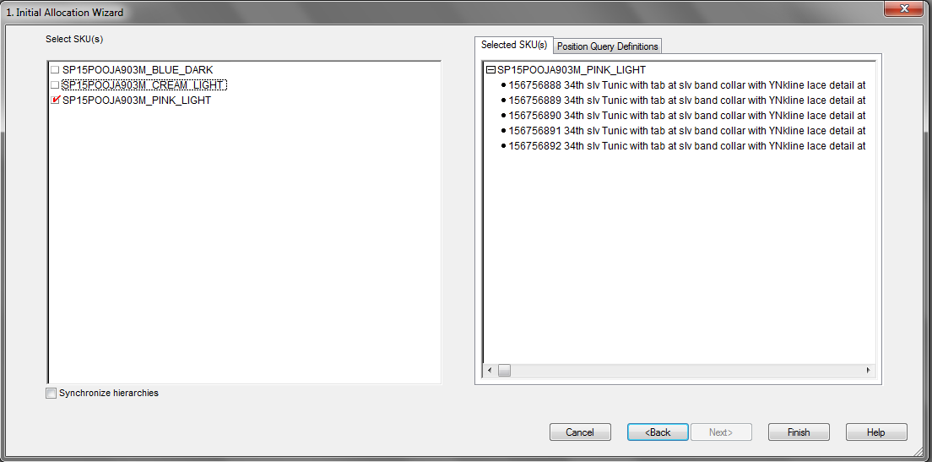
AP initial allocation review
Review AP Initial Allocation, create and approve new plan
Select Pack group to review. All Pack groups assigned to the Phase IDs selected during the previous step are pre-selected.

Slide 19
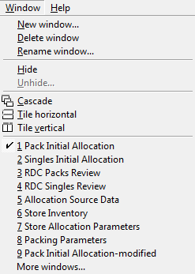
AP initial allocation review
Review AP Initial Allocation, create and approve new plan
Select “Window” → “1. Pack Initial Allocation” worksheet as shown below.

Slide 20
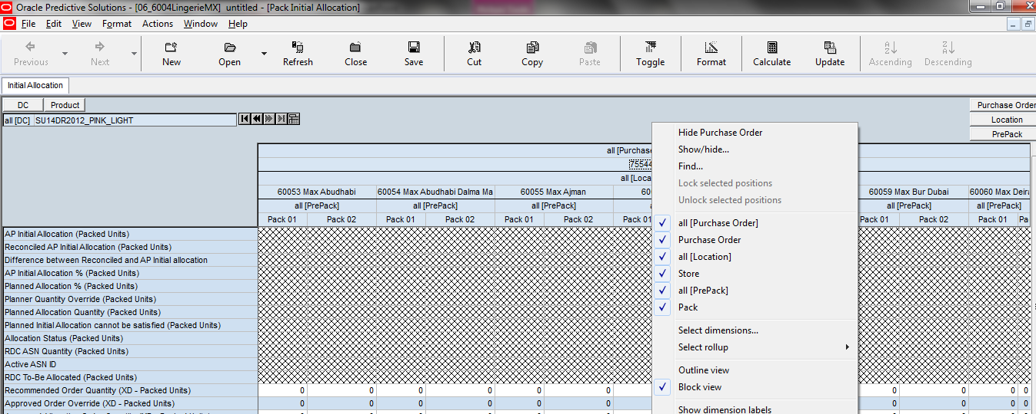
AP initial allocation review
Review AP Initial Allocation, create and approve new plan
Right click and Select “Outline View”
Aggregate Purchase Order to “all [Purchase Order]”.

Slide 21
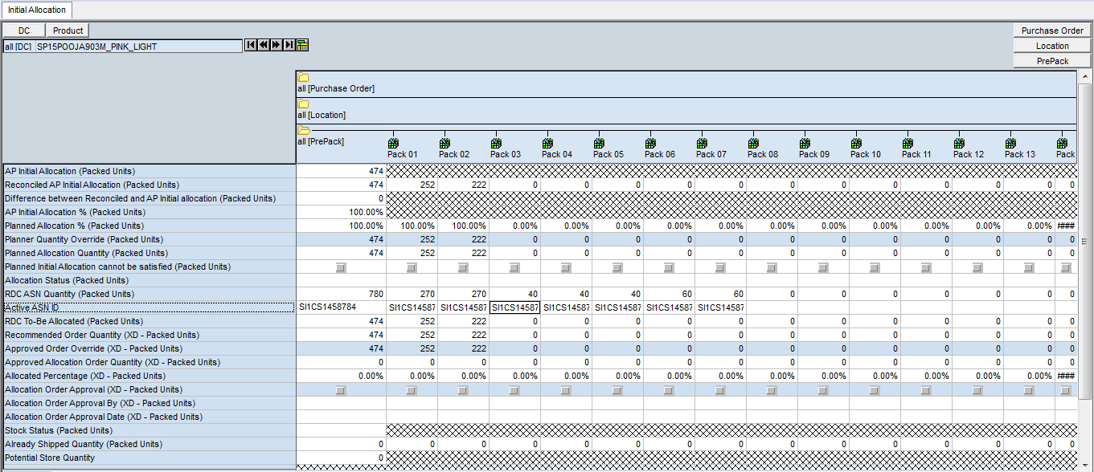
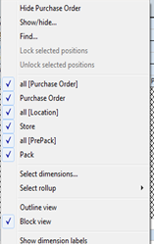
AP initial allocation review
Review AP Initial Allocation, create and approve new plan
Navigate to any of the Pack group that were selected during building the workbook. (If required, restrict the scope to positions with “Planned Initial Allocation” quantity using the PQD button).

Slide 22
AP initial allocation review
Review AP Initial Allocation, create and approve new plan
Navigate through the stores selected during the wizard steps. Review and validate “AP Initial Allocation”, “Reconciled AP Initial Allocation”, “Difference between Reconciled and AP Initial Allocation”, and “AP Initial Allocation %” values.
Check the “Recommended AP Initial Allocation” and how it relates to “AP Initial Allocation”.
Check the “AP Initial Allocation %” for each Store.
“AP Initial Allocation %” values should be the percentage across RDC Stores. “Reconciled AP Initial Allocation” used PO Quantity as a top-level constraint. Indicative results shown in the figure presented on the next slide.
Indicative results are shown in the figure included in the next slide.

Slide 23
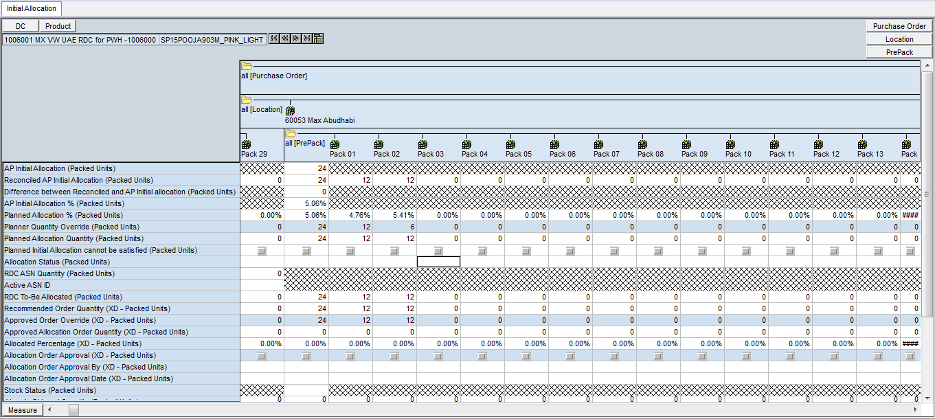
AP initial allocation review
Review AP Initial Allocation, create and approve new plan
Navigate to two of the stores selected during the wizard steps for one of the available Pack Group(s) and enter override values to “Planner Quantity Override” as shown in the image below.

Slide 24

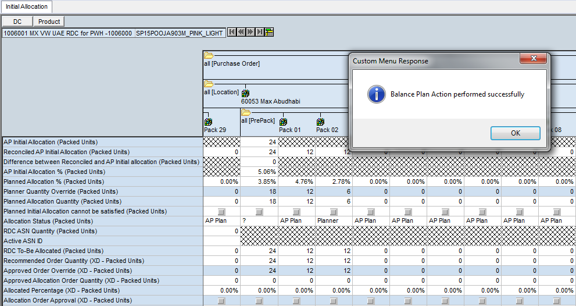
AP initial allocation review
Review AP Initial Allocation, create and approve new plan
Select “Actions” → “Balance Plan” from the Menu
“Allocation Status” should be changed to "Planner". Indicative results are shown below.

Slide 25
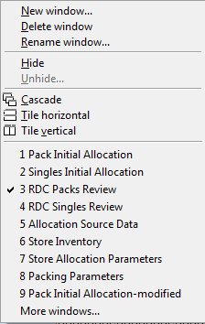
AP initial allocation review
Review AP Initial Allocation, create and approve new plan
Check for Stores where “Planned Initial Allocation” cannot be satisfied. “Planned Initial Allocation cannot be satisfied flag” should be false for all Stores.
Select “Window” → “3.RDC Packs Review” (see figure below). Review “Planned Allocation Quantity” values to make sure “PO Quantity” was distributed as desired among the territory stores and “Total Stock” was separated properly.

Slide 26
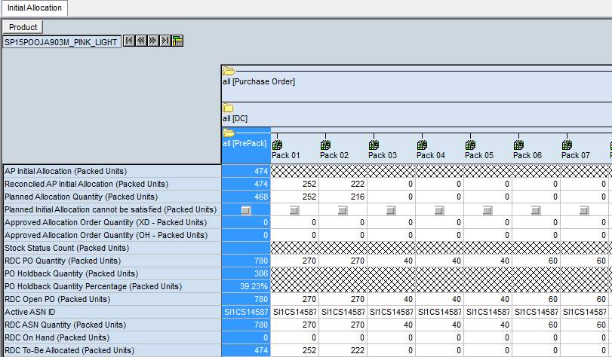
AP initial allocation review
Review AP Initial Allocation, create and approve new plan
Set the workbook as shown below (Using Select dimension and Outline view option)

Slide 27
AP initial allocation review
RDC Packs Review Worksheet
Approved Allocation Order Quantity (XD - Packed units): Default value will be equal to Planned Allocation Quantity for Cross Docked Orders. Given the Approved Order Override above, APX will reconcile the overrides with stock on hand and produce the final allocation order quantity in this measure. This is the quantity that will be exported to RMS.
Approved Allocation Order Quantity (OH - Packed units): Default value will be equal to Planned Allocation Quantity for On Hand Orders. Given the Approved Order Override above, APX will reconcile the overrides with stock on hand and produce the final allocation order quantity in this measure. This is the quantity that will be exported to RMS.

Slide 28
AP initial allocation review
RDC Packed units Review Worksheet
Stock Status Count (Packed units): Comma-separated store counts of Stock Status, per status. E.g.: “In Transit to RDC (3), Partially Approved (2), Partially Shipped (10)”.
RDC PO Quantity (Packed units): Total open PO quantities for this Pack group destined for this RDC.
RDC PO Holdback Quantity (Packed units): Total held-back PO quantities for this Pack group destined for this RDC.
RDC PO Holdback Quantity Percentage (Packed units): Percentage of the PO quantity that will be held-back at the RDC. When a user changes this number, then RDC PO Holdback Quantity (Packed units) will change accordingly when the Balance Plan is run.
RDC Open PO (Packed units): the quantity of all open Purchase Orders for the associated Pack group.
RDC On Hand (Packed units): Total RDC On Hand for this Pack group.
Reserved Stock for Allocation (Packed units): Stock reserved for allocation for specific Stores.
Available for Replenishment (Packed units): Stock on hand at the RDC that is not otherwise reserved (allocation, cross-docking) and thus is available for replenishment.

Slide 29
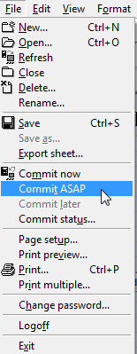
AP initial allocation review
Review AP Initial Allocation, create and approve new plan
Repeat the process until the desired AP Initial Allocation distribution is achieved and Planned Initial Allocation can be satisfied for the majority (if not all) of the Stores.
Commit your changes to approve the new plan.

Slide 30
Initial allocation review
Create cross-docking

Slide 31
Cross-docking initial allocation
Related Concepts
Recommended Order Quantity: When either ASN information is received or the stock is received at the RDC, APX will distribute the ASN /on-hand quantity as close as possible to the Planned Allocation Quantity following the Distribution Requirements. This measure will reflect the recommended order quantity for the allocation orders to be executed given ASN quantities and/or stock on hand
Approved Order Override: After APX creates the Recommended Order Quantity as described above, users will have the ability to override the quantity in this measure
Approved Allocation Order Quantity: Given the Approved Order Override above, APX will reconcile the overrides with ASN and/or stock on hand and produce the final allocation order quantity in this measure. This is the quantity that will be exported to RMS
Already Shipped Quantity: After Approved Allocation Order Quantity for both OH/Cross-docked orders is approved and RMS confirms its shipment to stores, the quantity will be moved here

Slide 32
Cross-docking initial allocation
Related Concepts
Stock Status: APX will set this measure to the following status messages:
“In Transit to RDC” if there are total ASN Quantities in transit to the RDC. This status will apply to both Cross-Docked and On-Hand allocations
“Received at RDC” if there any stock on hand reserved for Allocation at the RDC. This status will only be valid for On-Hand allocation orders
“Partially Approved” if Approved Allocation Order Quantity has been approved and is less than Planned Allocation Quantity
“Fully Approved” if Approved Allocation Order Quantity has been approved and is the equal to Planned Allocation Quantity
“Partially Shipped” if Already Shipped Quantity is non-zero and less than Planned Allocation Quantity. This status will apply to both Cross-Docked and On-Hand allocations.
“Fully Shipped” if Already Shipped Quantity is equal to Planned Allocation Quantity. This status will apply to both Cross-Docked and On-Hand allocations
“Store Delayed” if the Store allocation quantity is being held at the RDC or CDC

Slide 33
Cross-docking initial allocation
Related Concepts
Allocation Order Approval: APX users should check off this cell to release Approved Allocation Order Quantity for export to RMS and execution
Allocation Approved By: When Allocation Order Approval is checked off, this will store the user ID of the APX user approving the latest allocation order
Allocation Order Approval Date: When Allocation Order Approval is checked off, this will store the date and time of approval of the latest allocation order
Potential Store Quantity: This measure will contain the sum of the Store Net Inventory as well as a portion of the RDC Net Inventory based on the relative share of the demand forecast going forward
Constrained Capacity: This measure will contain the constrained capacity for the Capacity Group dimension of the Store

Slide 34
Cross-docking initial allocation
Review ASN, create cross-docking initial allocation and approve it
From the workbook tab “Allocation/Replenishment” select "Initial Allocation" as workbook template type and click "OK”.

Slide 35
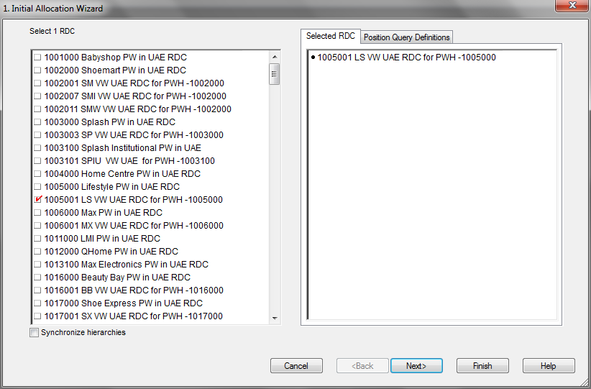
Cross-docking initial allocation
Review ASN, create cross-docking initial allocation and approve it
The “Initial Allocation Wizard” appears and prompts you to select one RDC. Proceed to an RDC selection.

Slide 36
Cross-docking initial allocation
Review ASN, create cross-docking initial allocation and approve it
Select Phase IDs for review.

Slide 37
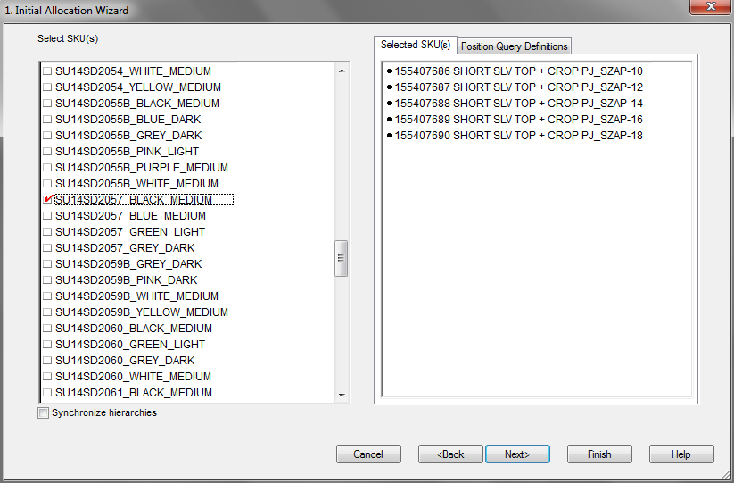
Cross-docking initial allocation
Review ASN, create cross-docking initial allocation and approve it
Select Pack group to review. All Pack groups assigned to the Phase IDs selected during the previous step are pre-selected.

Slide 38
Cross-docking initial allocation
Review ASN, create cross-docking initial allocation and approve it
Select Purchase Order(s) for review. Purchase Order(s) corresponding to Pack group selected during the previous step are preselected. Proceed with the list of preselected POs and click finish. The workbook is built.

Slide 39
Cross-docking initial allocation
Review ASN, create cross-docking initial allocation and approve it
Select “Window” → “1. Pack Initial Allocation” worksheet as shown below.

Slide 40
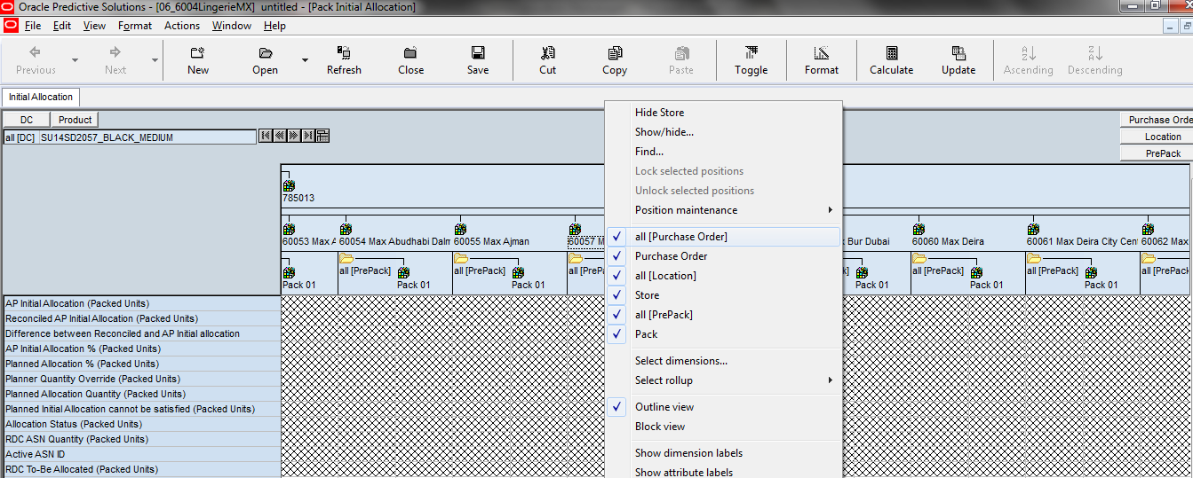
Cross-docking initial allocation
Review ASN, create cross-docking initial allocation and approve it
Right click and Select “Outline View”
Aggregate Purchase Order to “all [Purchase Order]”.

Slide 41
Cross-docking initial allocation
Review ASN, create cross-docking initial allocation and approve it
Navigate through the stores selected during the wizard steps. Review and validate “AP Initial Allocation”, “Reconciled AP Initial Allocation”, Difference between Reconciled and AP Initial Allocation, “Planned Initial Allocation”, “AP Initial Allocation %” and “Planned Initial Allocation %” values.
“AP Initial Allocation %” and “Planned Initial Allocation %” values should be the percentage across RDC Stores. “Reconciled AP Initial Allocation” used PO Quantity as a top-level constraint. Indicative results shown in figure below.

Slide 42

Cross-docking initial allocation
Review ASN, create cross-docking initial allocation and approve it
Check for Stores where Planned Initial Allocation cannot be satisfied.
Planned Initial Allocation cannot be satisfied flag should be false for all Stores.
Select “Actions” → “Recommend Orders” from the Menu. Review Recommended Order Quantities.
“Recommended Order Quantity (XD - Packed units)” should be equal to “Planned Allocation Quantity (Packed units)”.

Slide 43
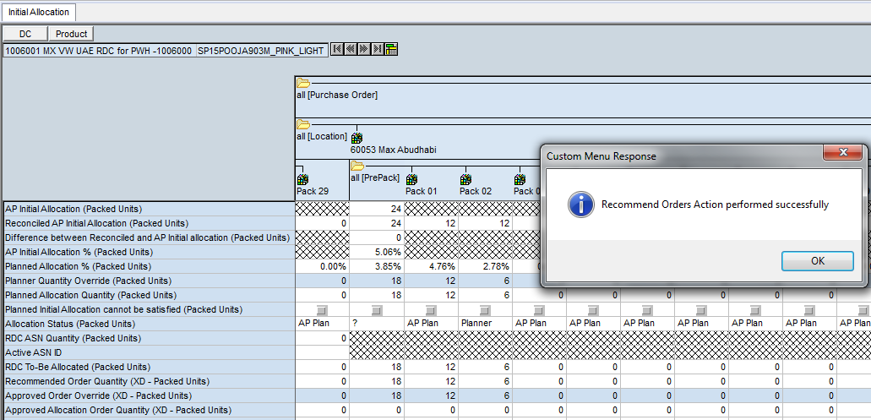
Cross-docking initial allocation
Review ASN, create cross-docking initial allocation and approve it

Slide 44
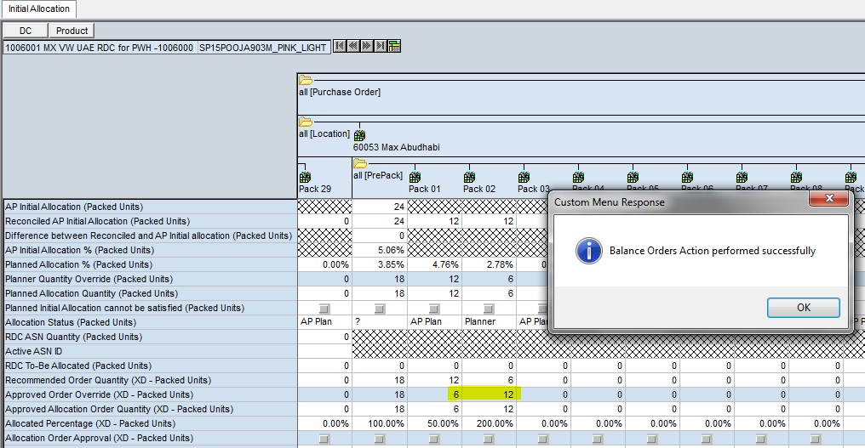
Cross-docking initial allocation
Review ASN, create cross-docking initial allocation and approve it
Navigate to one of the stores selected during the wizard steps for one of the Pack Group(s) selected and enter override values to “Approved Order Override (XD - Packed units)” as shown in the figure below.

Slide 45

Cross-docking initial allocation
Review ASN, create cross-docking initial allocation and approve it
Approved Order Override (XD - Packed units) values should be updated.
Select “Actions” → “Balance Orders” from the Menu.
“Approved Allocation Order Quantity (XD - Packed units)” values should be calculated.
Review “Approved Allocation Order Quantity (XD - Packed units)” values for Stores and respective Pack Group for which override values to “Approved Order Override (XD - Packed units)” were entered in the previous slide.
If for example the override value for one store/pack combination is higher than the “Planned Allocation Quantity (Packed units)”, “Approved Allocation Order Quantity (XD - Packed units)” for the remaining Packed units should be zero. Indicative results are shown in the figure on the next slide.

Slide 46
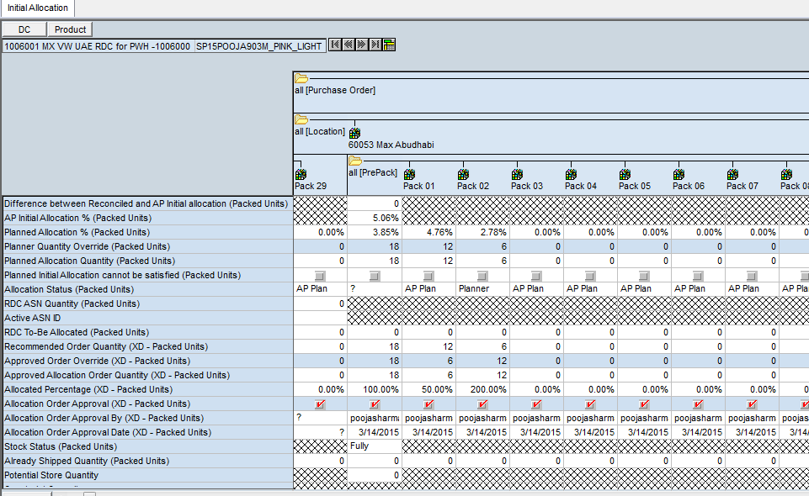
Cross-docking initial allocation
Review ASN, create cross-docking initial allocation and approve it

Slide 47
Cross-docking initial allocation
Review ASN, create cross-docking initial allocation and approve it
Review “Allocated % (XD - Packed units)” and “Stock Status (Packed units)” for Stores and respective Pack group for which override values to “Approved Order Override (XD - Packed units)” were entered in the previous slide.
For example “Allocated % (XD - Packed units)” could be 120% at Pack group level for a specific store/Pack group combination (equal to 24/20). Indicative results are shown in the figure in the next slide.

Slide 48
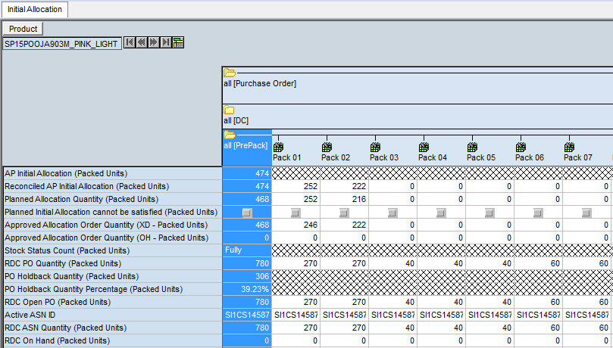
Cross-docking initial allocation
Review ASN, create cross-docking initial allocation and approve it
Select Window → “3.RDC Pack Review”.
“RDC Pack Review” worksheet is shown.
Select Outline View. Worksheet view should be updated.

Slide 49
Cross-docking initial allocation
Review ASN, create cross-docking initial allocation and approve it
Review “Planned Allocation Quantity (Packed units)”, “Approved Allocation Order Quantity (XD - Packed units)”, “Approved Allocation Order Quantity (OH - Packed units)” and “Stock Status Count (Packed units)”.
Review “RDC To-Be Allocated (Packed units)”.
For example “RDC To-Be Allocated (Packed units)” could 2 units. This could be due to a partially approved store (e.g. 2 instead of 3 units of Planned Allocation Quantity (Packed units))

Slide 50
Initial allocation review
On-hand initial allocation

Slide 51
On-hand initial allocation
Review ASN, create cross-docking initial allocation and approve it
From the workbook tab “Allocation/Replenishment” select "Initial Allocation" as workbook template type and click "OK”.

Slide 52
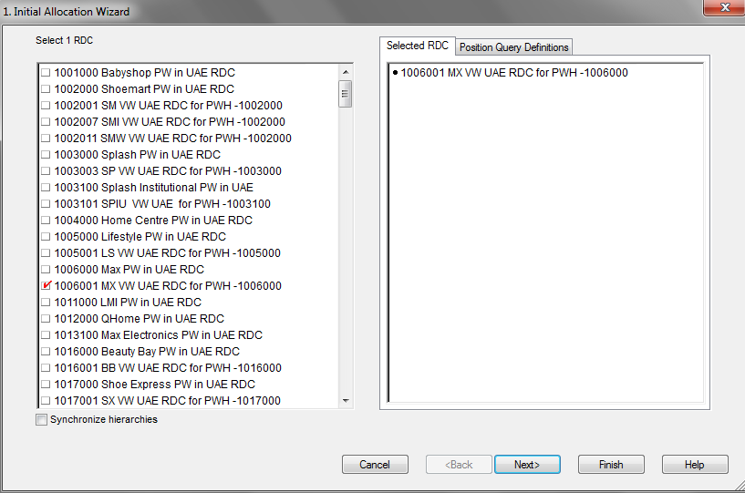
On-hand initial allocation
Review ASN, create cross-docking initial allocation and approve it
The “Initial Allocation Wizard” appears and prompts you to select one RDC. Proceed to an RDC selection.

Slide 53
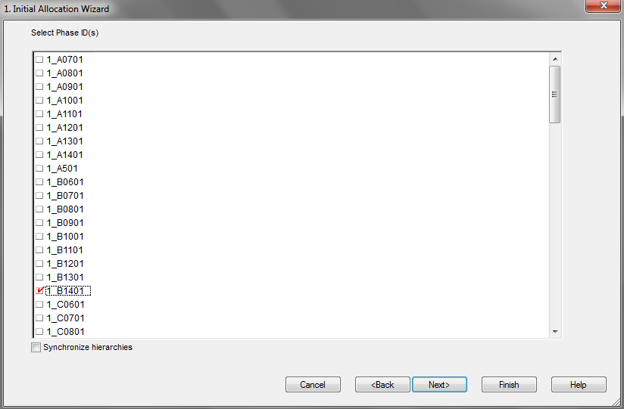
On-hand initial allocation
Review ASN, create cross-docking initial allocation and approve it
Select Phase IDs for review.

Slide 54
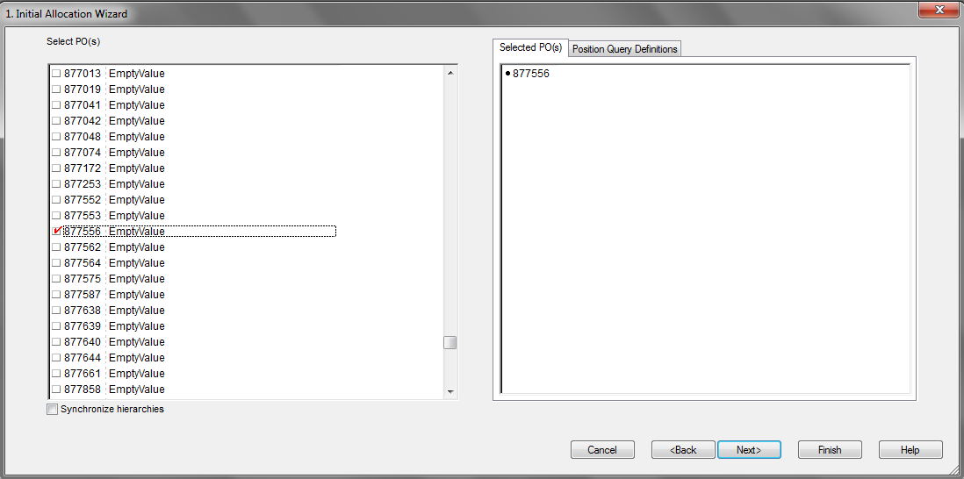
On-hand initial allocation
Review ASN, create cross-docking initial allocation and approve it
Select Purchase Order(s) for review. Purchase Order(s) corresponding to Pack group selected during the previous step are preselected. Proceed with the list of preselected POs and click finish. The workbook is built.

Slide 55
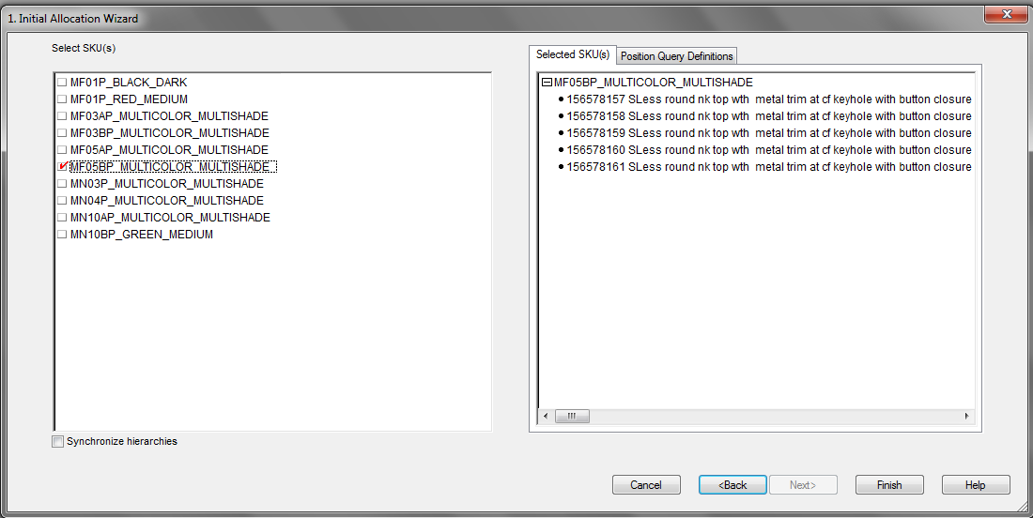
On-hand initial allocation
Review ASN, create cross-docking initial allocation and approve it
Select Pack group to review. All Pack groups assigned to the Phase IDs selected during the previous step are pre-selected.

Slide 56
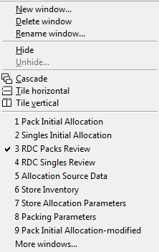
On-hand initial allocation
Review AP Initial Allocation, create and approve new plan
Check for Stores where “Planned Initial Allocation” cannot be satisfied. “Planned Initial Allocation cannot be satisfied flag” should be false for all Stores.
Select “Window” → “3.RDC Packed units Review” (see figure below). Review “Planned Allocation Quantity” values to make sure “PO Quantity” was distributed as desired among the territory stores and “Total Stock” was separated properly.

Slide 57
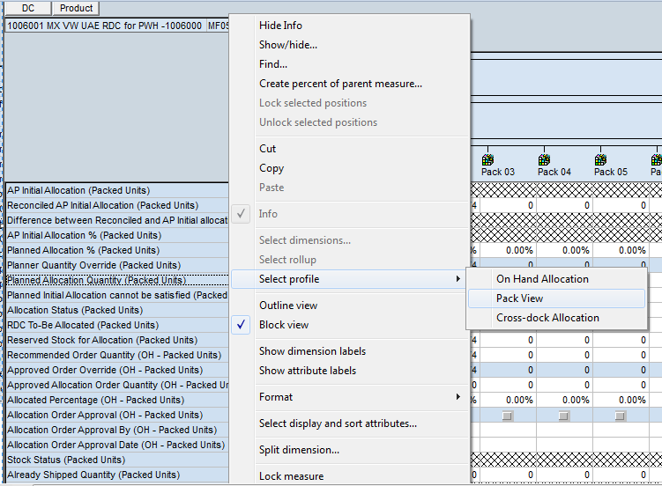
On-hand initial allocation
Review AP Initial Allocation, create and approve new plan
Set the workbook as shown below (Using Select dimension and Outline view option)

Slide 58
On-hand initial allocation
Review ASN, create cross-docking initial allocation and approve it
Review “Planned Allocation Quantity (Packed units)”, “Stock Status Count (Packed units)”, “RDC Open PO (Packed units)”, “RDC On Hand (Packed units)”, “RDC To-Be Allocated (Packed units)”, “Reserved Stock for Allocation (Packed units)” and “Available for Replenishment (Packed units)” values.
“Reserved Stock for Allocation” should be equal to the minimum between (“RDC To Be Allocated” – “Total RDC Open PO”) and “RDC Stock on Hand” (see figure on next slide).

Slide 59
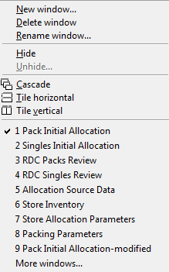
On-hand initial allocation
Review ASN, create cross-docking initial allocation and approve it
Select “Window” → “1. Pack Initial Allocation” worksheet as shown below.

Slide 60
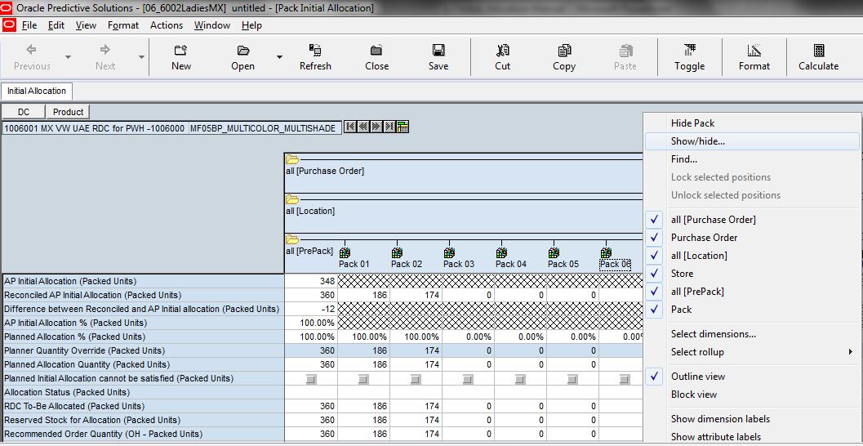
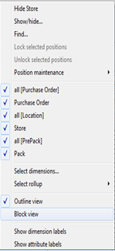
On-hand initial allocation
Review AP Initial Allocation, create and approve new plan
Right click and Select “Outline View”
Aggregate Purchase Order to “all [Purchase Order]”.

Slide 61
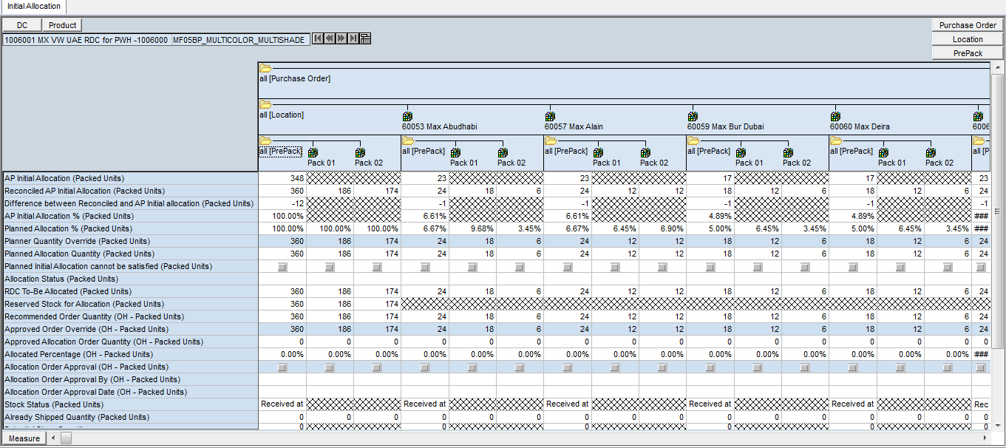
On-hand initial allocation
Review AP Initial Allocation, create and approve new plan
Navigate to any of the Pack group that were selected during building the workbook. (If required, restrict the scope to positions with “Planned Initial Allocation” quantity using the PQD button).

Slide 62
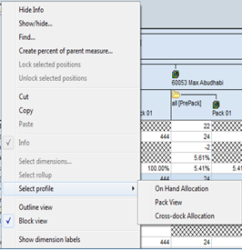
On-hand initial allocation
Review On Hand stock, create allocation order from Stock On Hand
Click “Select Profile” → “On Hand Allocation”

Slide 63
On-hand initial allocation
Review On Hand stock, create allocation order from Stock On Hand
Navigate to two of the Stores selected during the wizard steps for a particular Pack Group. Review and “Validate AP Initial Allocation”, “Reconciled AP Initial Allocation”, “Difference between Reconciled and AP Initial Allocation”, “Planned Initial Allocation”, “AP Initial Allocation %” and “Planned Initial Allocation %” values.
“AP Initial Allocation %” and “Planned Initial Allocation %” values should be the % across RDC Stores. “Reconciled AP Initial Allocation” used PO Quantity as a top-level constraint. Indicative results shown in the figure below.
Check for Stores where Planned Initial Allocation cannot be satisfied.
“Planned Initial Allocation cannot be satisfied flag” should be false for all Stores.

Slide 64
On-hand initial allocation
Review On Hand stock, create allocation order from Stock On Hand

Slide 65

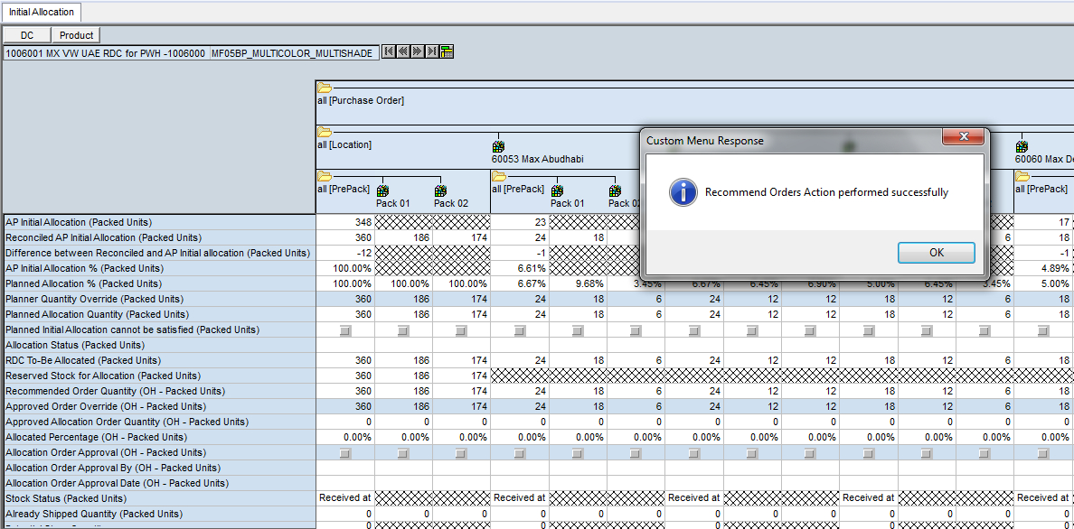
On-hand initial allocation
Review On Hand stock, create allocation order from Stock On Hand
Select “Actions” → “Recommend Orders” from the Menu.
Review Recommended Order Quantities.

Slide 66
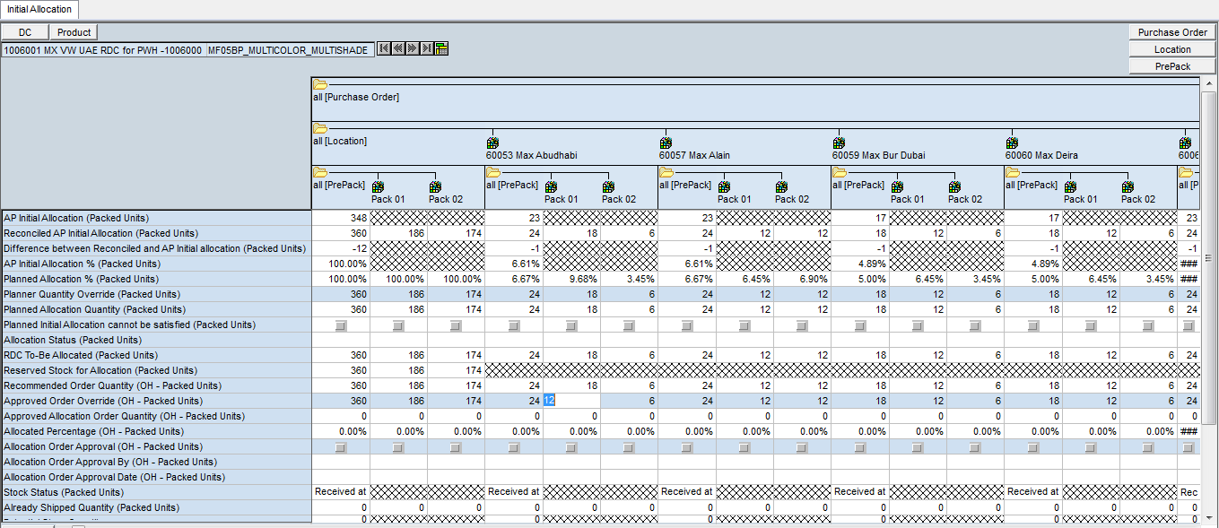
On-hand initial allocation
Review On Hand stock, create allocation order from Stock On Hand
Enter override values to “Approved Order Override (OH - Packed units)” as in the example illustrated shown in the figure below.
Approved “Order Override (OH - Packed units) values should be updated”.

Slide 67

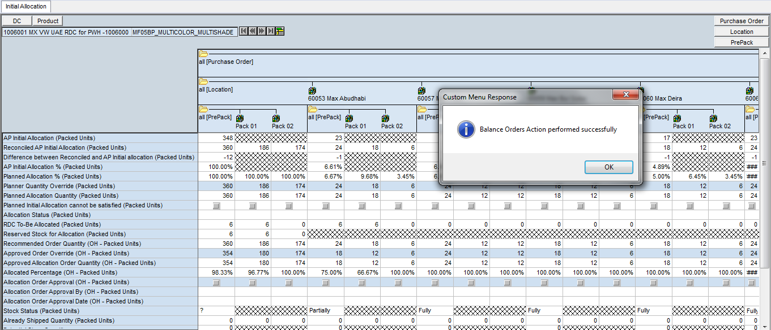
On-hand initial allocation
Review On Hand stock, create allocation order from Stock On Hand
Select “Actions” → “Balance Orders” from the Menu.
Approved “Allocation Order Quantity
(OH - Packed units)” values should be calculated.
Navigate to Stores/Pack Group combinations for which override values were entered as described in the previous slide. Review “Approved Allocation Order Quantity (OH - Packed units)” values.
“Approved Allocation Order Quantity (OH - Packed units)” values should be updated according to override values entered (see indicative figure below).

Slide 68
On-hand initial allocation
Review On Hand stock, create allocation order from Stock On Hand
Review “Allocated % (OH - Packed units)” and “Stock Status (Packed units)” for one of the Store/Pack Group combinations for which override values were entered.
For example, “Allocated % (OH - Packed units)” could be 100% at Pack Group level (all Prepack) for this Store/Pack Group combination. Indicative results are shown in the figure below.

Slide 69
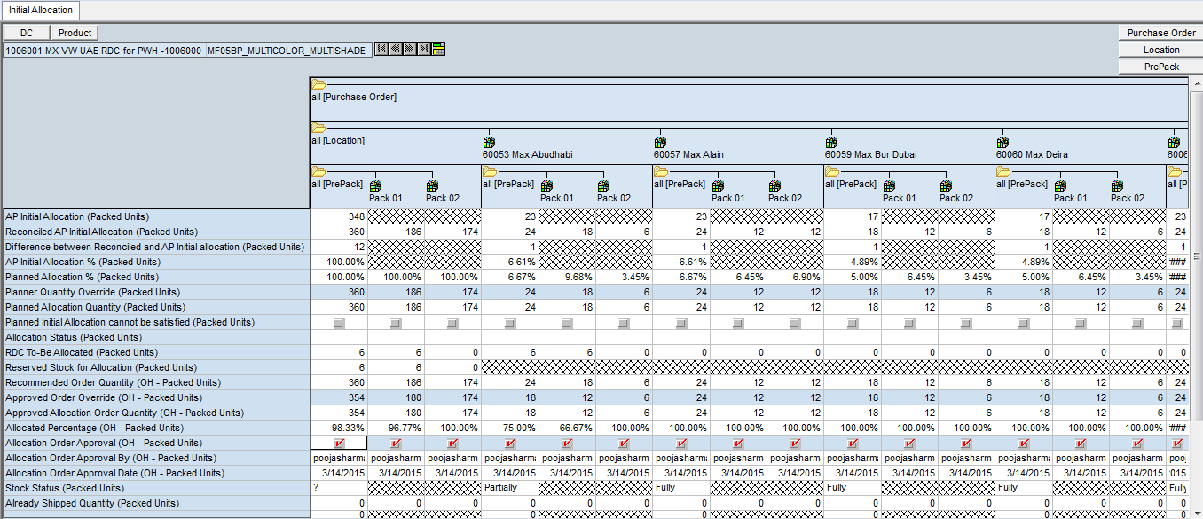

On-hand initial allocation
Review On Hand stock, create allocation order from Stock On Hand
Click “Allocation Order Approval (OH - Packed units)” at packgroup/option level.
Click Calculate.

Slide 70
On-hand initial allocation
Review On Hand stock, create allocation order from Stock On Hand
“Allocation Order Approval (OH - Packed units)”, “Allocation Order Approval By (OH - Packed units)” and “Allocation Order Approval Date (OH - Packed units)” values should be updated as shown in the example figure below.

Slide 71
Initial allocation review
Reference other worksheets

Slide 72
Reference – other worksheets
Related Concepts
CDC Net Inventory: Net Inventory at the primary CDC
CDC Allocation Quantity Already Shipped: Already shipped delayed allocation quantities from the primary CDC (at CDC/Pack group level).
CDC Remaining For Replenishment: Stock remaining for replenishment at the primary CDC
CDC Reserved for Allocation: Stock reserved for allocation to delayed stores at the primary CDC
CDC Total ASN Qty: Total ASN quantity destined to the primary CDC
CDC PO Qty: Total PO quantity destined to the primary CDC
In Transit from CDC (Packed units): Total in-transit stock to this RDC from its primary CDC.

Slide 73
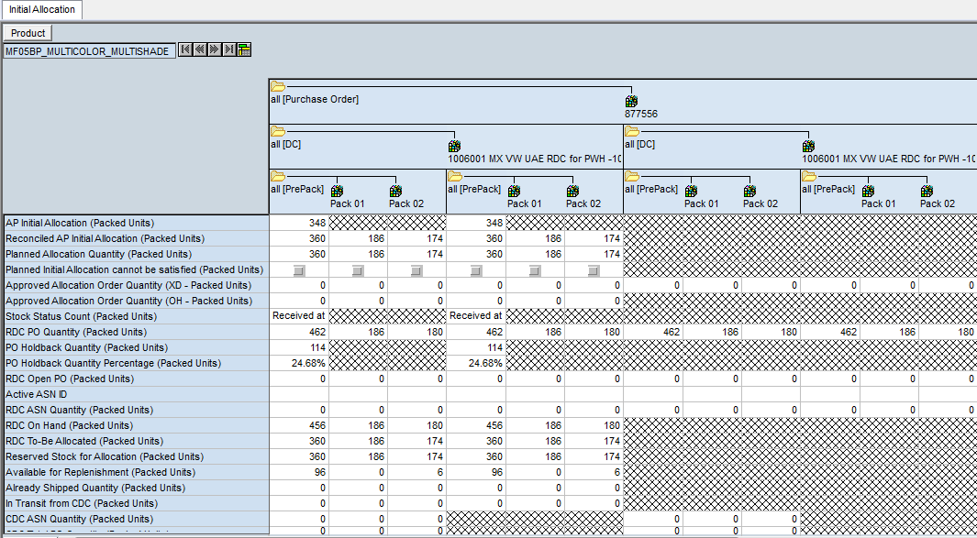
Reference – other worksheets
RDC Packed units View
These worksheets contain total views of Allocation quantities plus some Stock on hand and PO information for Packed units

Slide 74
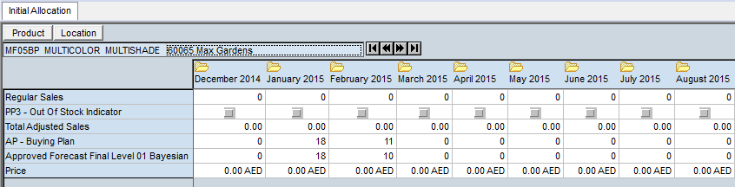
Reference – other worksheets
Allocation Source Data
This worksheet includes low-level input data that are inputs to the allocation calculation, for review by the users.

Slide 75
Reference – other worksheets
Initial Source Data
Regular Sales: the real regular sales, excluding clearance and promotional sales.
PP3 – Out of Stock Indicator: Indicates a stock outage situation.
Total Adjusted Sales: the total Adjusted Sales after Preprocessing.
AP – Buying Plan: the Assortment Planning Buy Plan quantities.
Approved Forecast Final Level 01 Bayesian: the approved RDF forecast.
Price: the item retail price.

Slide 76
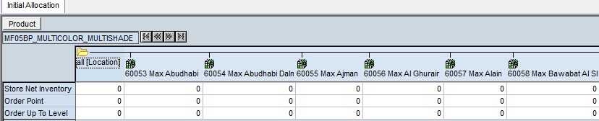
Reference – other worksheets
Store Inventory
This worksheet contains Pack group/Store-level information on Net Inventory and the results of the APX Recommended Initial Allocation process
Store Net Inventory: The amount of stock available to cover the need for the next order.
Order Point: The minimum number of units you want on hand for the item. When the net available inventory falls below the order point, the item is replenished.
Order up to Level: the amount that the net available inventory should be raised up to.

Slide 77
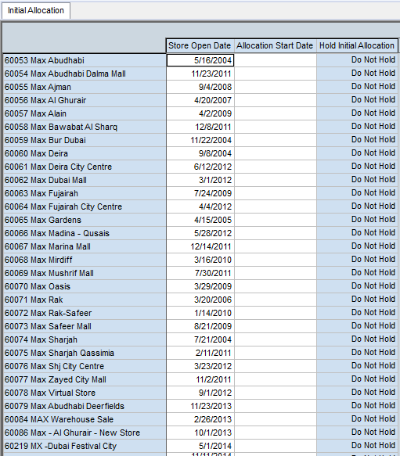
Reference – other worksheets
Store Allocation Parameters
This worksheet contains Store-level parameters that control Allocation behavior, i.e. reserving the stock for delayed Stores (either RDC or CDC) or release the stock to proceed with Initial Allocation

Slide 78
Reference – other worksheets
Packing Parameters
This worksheet contains the Cover Method setting at Store/Pack Group used to determine whether a candidate store has its need covered for a specific pack
Cover Method: three options will be available in APX to consider a candidate store has its need covered for a specific pack, as per standard APX functionality:
Cover full request: Store Inventory must be equal or higher than Request for all Pack groups of the Pack.
Cover full need and closest to request: Store Inventory must be equal or higher than Need for all Pack groups of the Pack AND over/under against the request for all Pack groups in the Pack must be minimal.
Cover full need and request for 1 plus item(s): Store Inventory must be equal or higher than Need for all Pack groups of the Pack AND Store Inventory must be equal or higher than Request for 1 or more item(s) in the Pack.

Slide 79
Initial allocation review
Cancel delayed store

Slide 80

Delayed store cancellation
Cancel Delayed Store, release allocation stock
Build the workbook by following the steps described in the first test scenario (AP initial allocation review).
Select “Window” → “1. Pack Initial Allocation”.

Slide 81
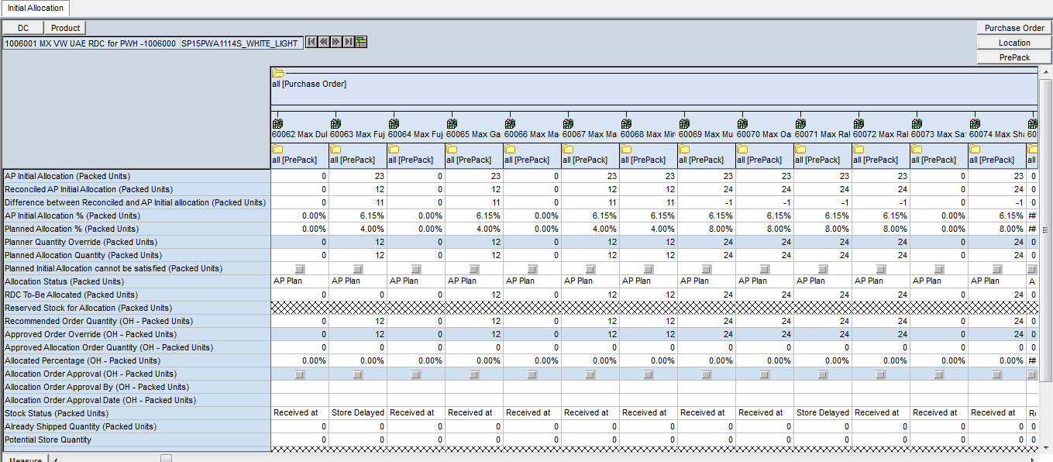
Delayed store cancellation
Cancel Delayed Store, release allocation stock
Navigate through the stores selected during the wizards steps for a specific Pack Group. Review “AP Initial Allocation”, “Reconciled AP Initial Allocation” and “Planned Allocation Quantity” values. Check “RDC To-Be Allocated (Packed units)” and “Recommended Order Quantity (OH - Packed units)” values.
“Reconciled AP Initial Allocation” used PO Quantity as a top-level constraint. “RDC To-Be Allocated” should be equal to “Planned Allocation Quantity (Packed units)”.
“Recommended Order Quantities” could be zero at some of the stores if they are held back at RDC. Indicative results are shown in the figure below.

Slide 82
Delayed store cancellation
Cancel Delayed Store, release allocation stock
Review “Stock Status (Packed units)” measure for the stores selected during the wizard steps and locate a store for which its value is “Store Delayed”.

Slide 83
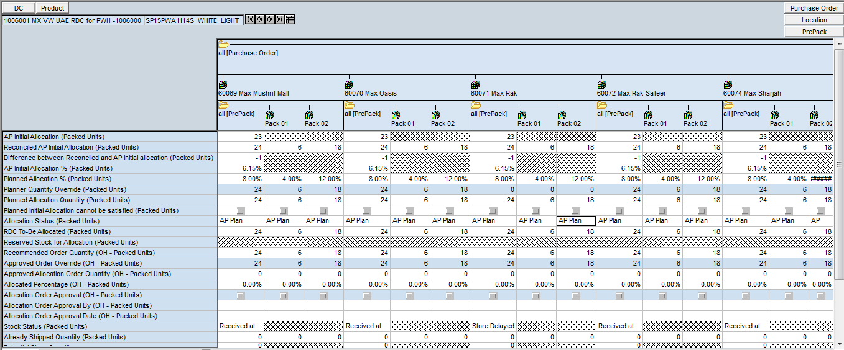
Delayed store cancellation
Cancel Delayed Store, release allocation stock
Enter override and zero out the “Planner Quantity Override” measure value at Pack group level for the store mentioned in the previous slide as shown, for example, in the figure below. “Planner Quantity Override (Packed units)” values should be updated.

Slide 84

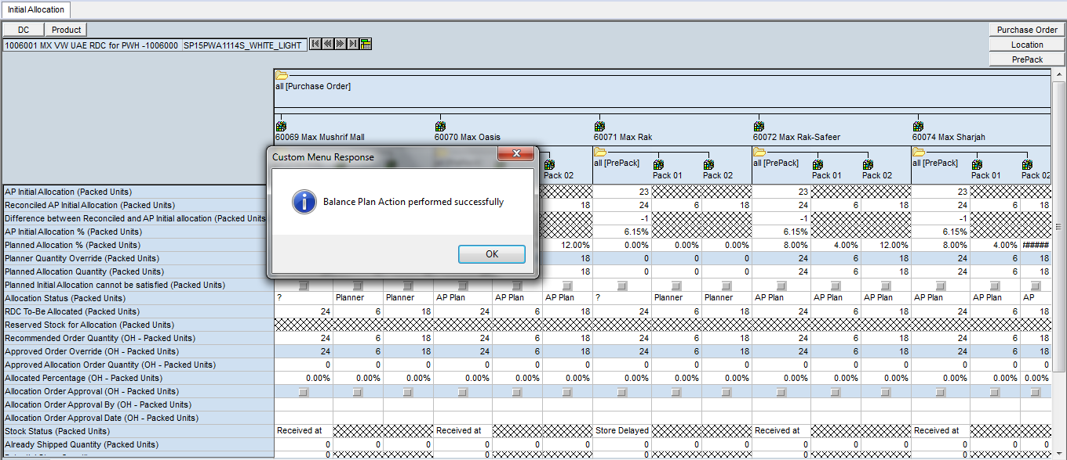
Delayed store cancellation
Cancel Delayed Store, release allocation stock
From the menu select “Actions” → “Balance Plan”.
“Planned Allocation (%)” and “Planned Allocation Quantity (Packed units)” should be updated and equal to zero. Allocation Status should be changed to "Planner Override". Indicative results are shown in the figure below.

Slide 85

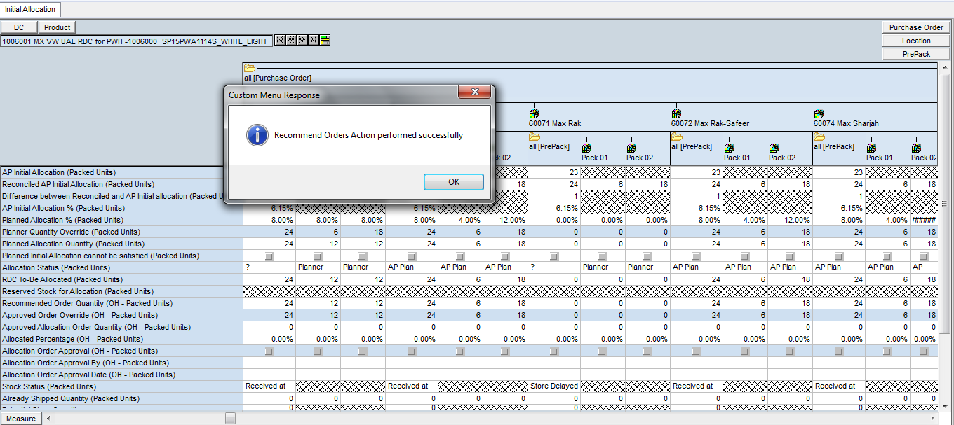
Delayed store cancellation
Cancel Delayed Store, release allocation stock
Select “Actions” → “Recommend Orders” in order to update
Recommended Order Quantities and review the values.
“RDC To-Be Allocated (Packed units)” should be updated and equal to zero, since the delayed store is now cancelled. Indicative results are shown in the figure below.

Slide 86
Delayed store cancellation
Cancel Delayed Store, release allocation stock
Proceed as described in the previous two scenarios (Review ASN, create cross docking initial allocation and approve it/Review OH stock, create allocation order from SOH, excluding the cancelled Store from your desired Allocation distribution.

Slide 87
Initial allocation review
Cdc delayed stores

Slide 88
Cdc delayed stores
Release CDC Delayed Store
Build the workbook by following the steps described in the first test scenario (AP initial allocation review).
Select “Window” → “1. Pack Initial Allocation”

Slide 89
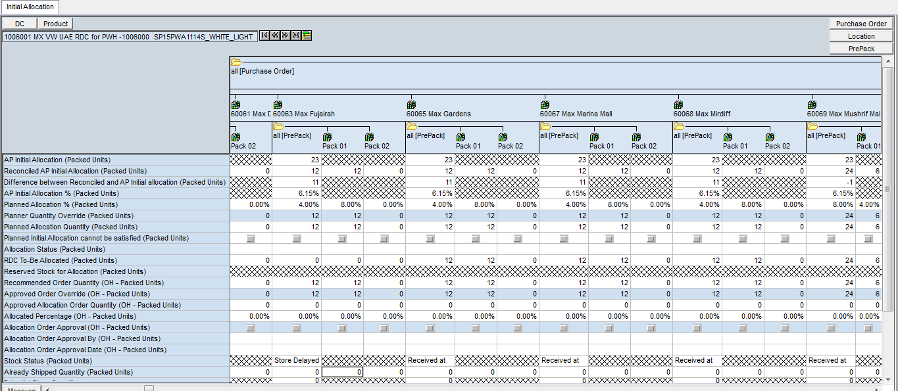
Cdc delayed stores
Cancel Delayed Store, release allocation stock
Review “Stock Status (Packed units)” measure for the stores selected during the wizard steps and locate a store for which its value is “Store Delayed”.

Slide 90
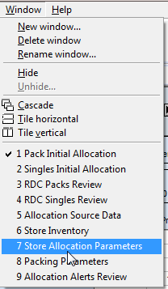
Cdc delayed stores
Release CDC Delayed Store
Select “Window” → “7. Store Allocation Parameters”. Store Allocation Parameters Worksheet is shown.

Slide 91
Cdc delayed stores
Release CDC Delayed Store
Hold Initial Allocation: Writable picklist where APX users will be able to modify Allocation behavior using this setting, which has three allowed values:
“Do Not Hold”: this allows Allocation to proceed as described previously in this manual.
“Hold in RDC”: when selected, APX will reserve the Planned Allocation Quantity for this Store at RDC after allowing for the initial allocation of other stores under the same RDC but before making any other stock available for replenishment.
“Hold in CDC”: when selected, APX will reserve the Planned Allocation Quantity for this Store at CDC after allowing for the initial allocation of other stores under the same CDC but before making any other stock available for replenishment.
After the value of the pick list is changed, then the Balance Plan custom action needs to be run, in order to hold or release the allocation quantity and redo the calculations based on the new quantity available.

Slide 92


Cdc delayed stores
Release CDC Delayed Store
Select “Hold Initial Allocation” measure and review the values. Verify that some of the stores are held back in CDC.
Select one of the delayed stores and change the value of “Hold Initial Allocation” measure to “Do Not Hold” in order to release the Delayed Store. Click “Calculate”. “Hold Initial Allocation” values should be updated.
Next Day batch calculations for Allocation at Tier 1 will take place

Slide 93
Initial allocation review
rdc delayed stores

Slide 94
Rdc delayed stores
Release CDC Delayed Store
Build the workbook by following the steps described in the first test scenario (AP initial allocation review).
Select “Window” → “1. Pack Initial Allocation”

Slide 95
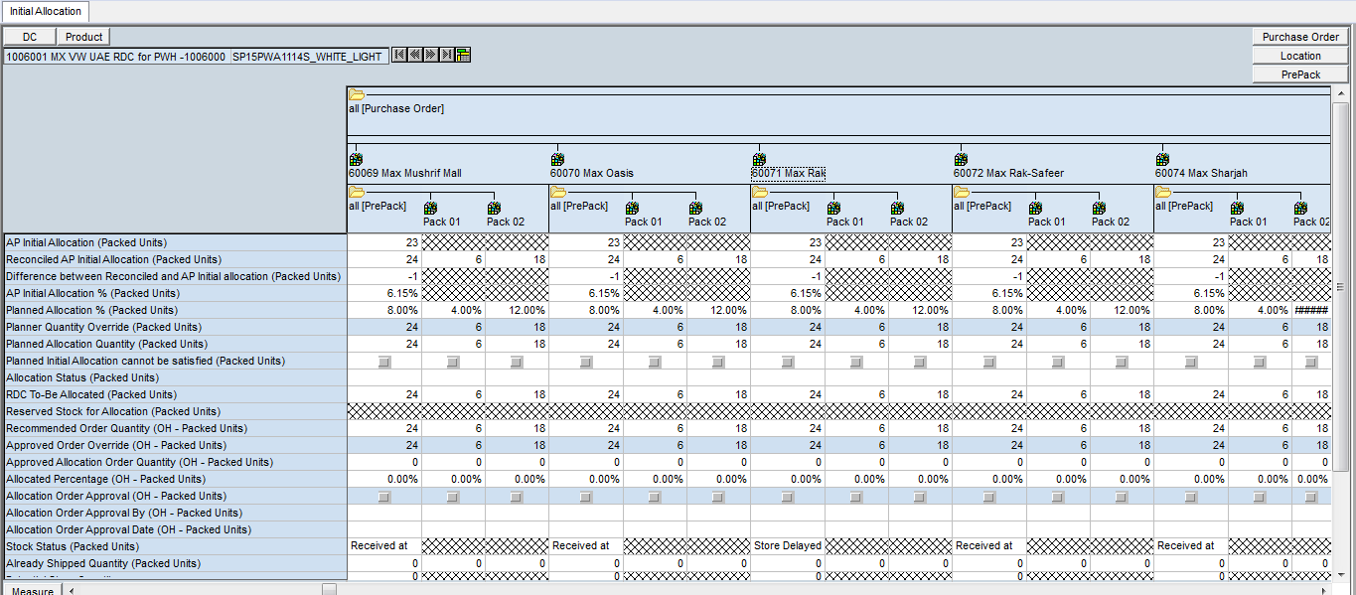
Rdc delayed stores
Cancel Delayed Store, release allocation stock
Review “Stock Status (Packed units)” measure for the stores selected during the wizard steps and locate a store for which its value is “Store Delayed”.

Slide 96
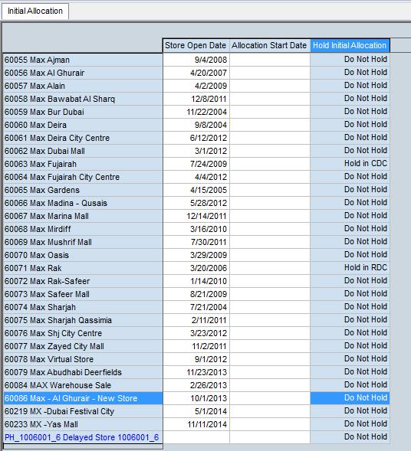
Rdc delayed stores
Release RDC Delayed Store
Select “Window” → “7. Store Allocation Parameters”. Store Allocation Parameters
Worksheet is shown.
Select Hold Initial Allocation measure and review the values. Verify that some
stores are held back in RDC. For example, inspect the figure below.

Slide 97
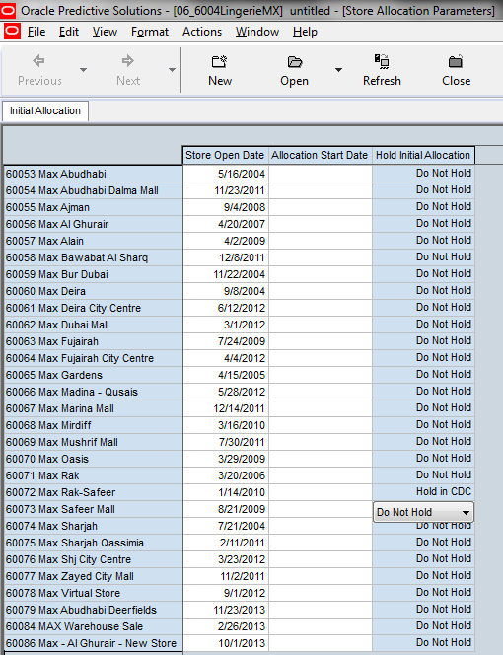
Rdc delayed stores
Release RDC Delayed Store
Select one of the stores that are held back in RDC and change the value of “Hold Initial Allocation” measure to “Do Not Hold” in order to release the Delayed Store. Click “Calculate”. “Hold Initial Allocation” values should be updated.

Slide 98
Rdc delayed stores
Release RDC Delayed Store
Return to “Pack Initial Allocation” Worksheet. Select “Window” → “1. Pack Initial Allocation”. Pack Initial Allocation worksheet is shown.
Navigate to the newly released store. Select “Actions” → “Recommend Orders” from the Menu in order to update “Recommended Order Quantity (OH - Packed units)”
enter values for the delayed store.

Slide 99

Rdc delayed stores
Release RDC Delayed Store
Review values in the screen
Proceed as described in the previous scenarios (Review ASN, create cross docking initial allocation and approve it/Review OH stock, create allocation order from SOH), excluding the cancelled Store from your desired Allocation distribution.

